Slide 1

SCHOOL OF ELECTRICAL & ELECTRONICS ENGINEERING B.TECH Topic-Approval & Progress Presentation On
IoT BASED SMART HELMET FOR INDUSTRIAL WORKERS
GROUP MEMBER:
SUKANYA (21BAC10022)
LAXMI PARMAR (21BAC10033)
GUIDED BY:
Dr. ANIRBAN BHOWMICK
Designation: Assistant Professor

Slide 2
CONTENTS
♦ INTRODUCTION
♦ OBJECTIVE
♦ PROGRESS AFTER 2ND REVIEW
♦ COMPONENTS
♦ METHODOLOGIES
♦ SIMULATION
♦ RESULT

Slide 3

INTRODUCTION
We are working on a project which is IoT based smart helmet for industrial workers. The worker’s current location will be detected in real-time while they are working at the mining site. In case of emergency, the buzzer will be on to create an alert to the management, and rescue operations can begin immediately shared over IoT’s web interface.

Slide 4
OBJECTIVE
♦Wireless sensors network for monitoring real time situation of working environment from monitoring station.
♦To protect the miners head from several injuries.
♦Tracks the environment of the mining site and evaluates the safety parameters.
♦Transferring data through the IoT network from working place to monitoring station.

Slide 5
PROGRESS AFTER 2ND REVIEW
♦ We simulated our circuit.
♦ Completed the coding part.
♦ Tested the model and objective met.
♦ Model is working properly.

Slide 6
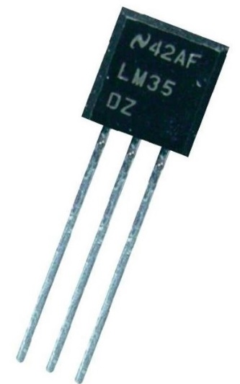
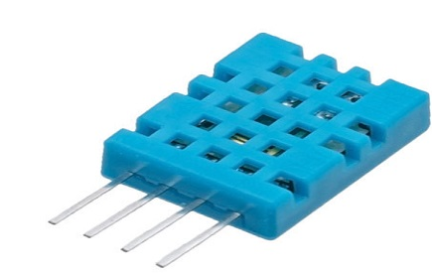
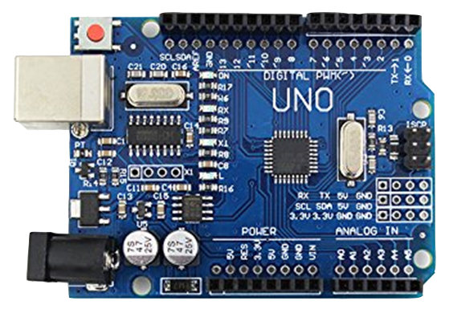
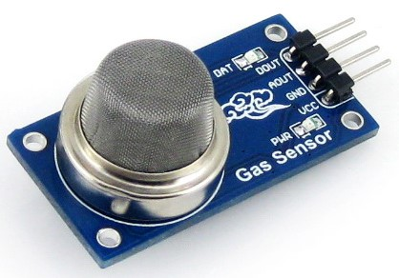
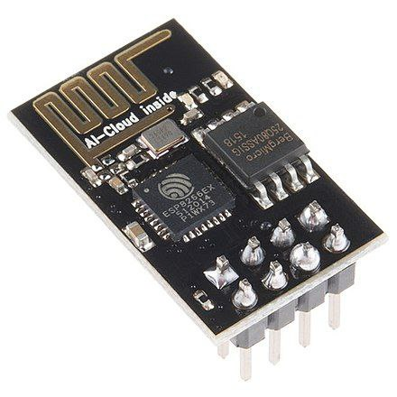
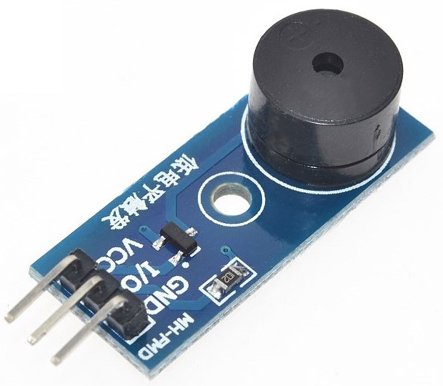
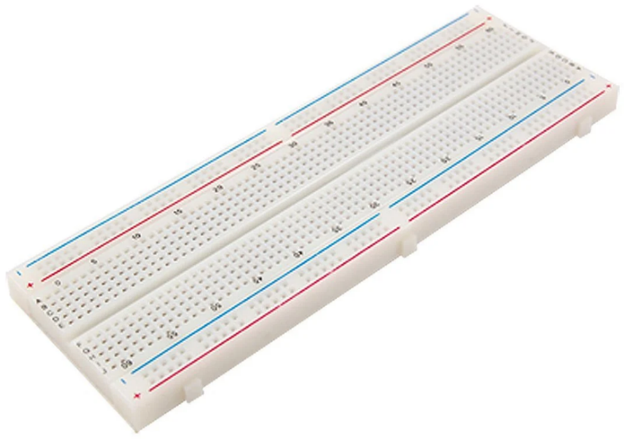
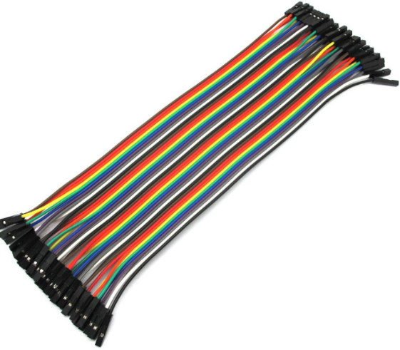
COMPONENTS
Arduino UNO Atmega328p
LM-35 Temperature Sensor
MQ135 Gas Sensor
DHT11 Humidity Sensor
Breadboard
ESP8266
Jumper Wires
Buzzer Module

Slide 7
METHODOLOGY
♦The working of this project is based on sensing the environment condition and sending it to monitoring station.
♦ Temperature sensor will detect the current surroundings temperature.
♦ Gas sensor will detect the smoke condition of the surroundings.
♦ Whenever the smoke or temperature value cross the threshold level, the buzzer will be on.
♦The system makes use of Atmega microcontroller to receive the data transmitted by worker helmet nodes.

Slide 8
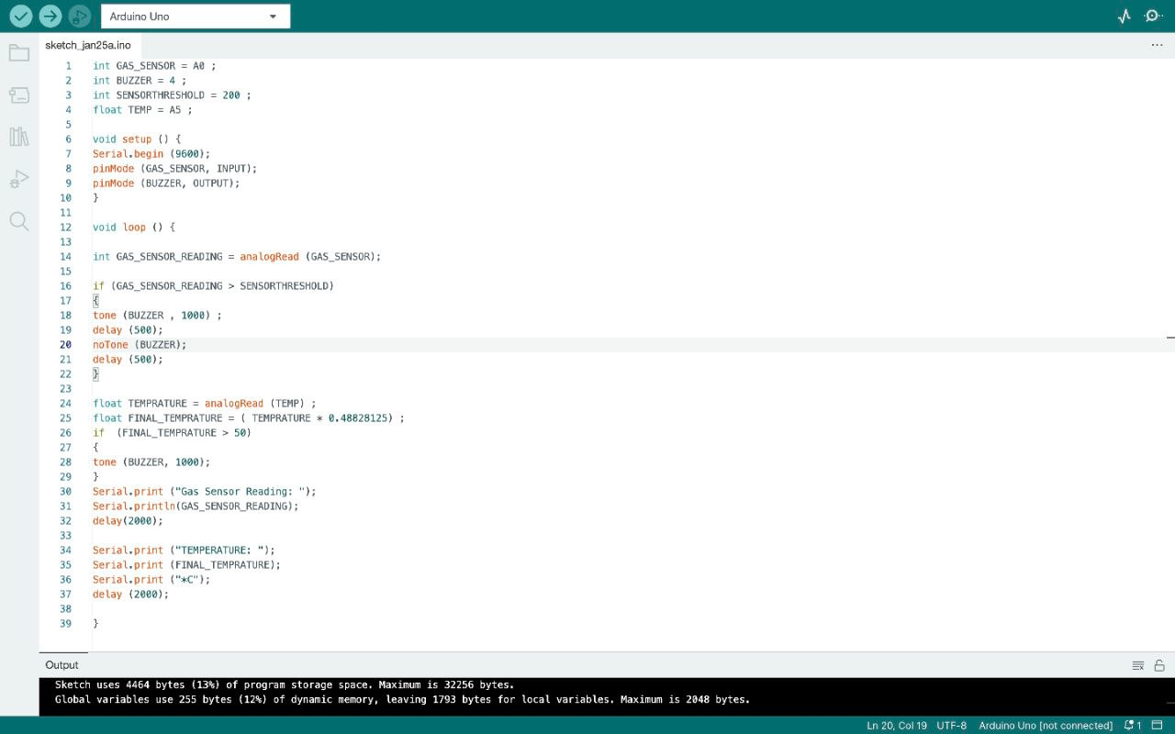

Slide 9
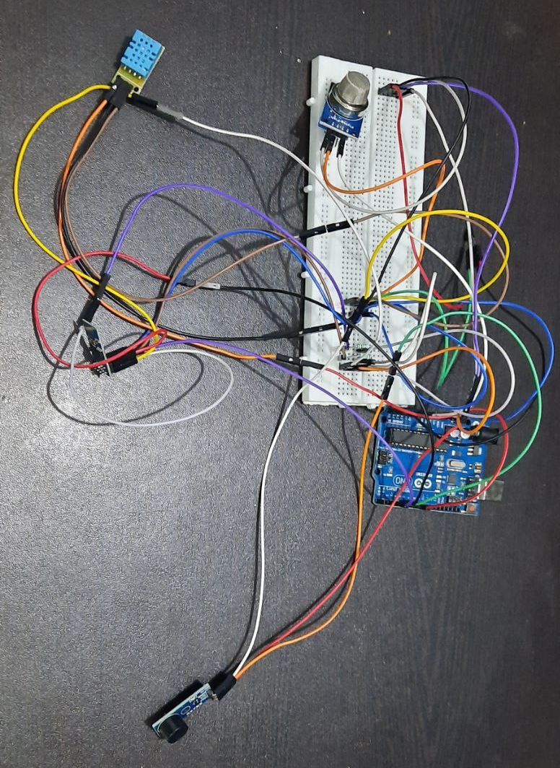
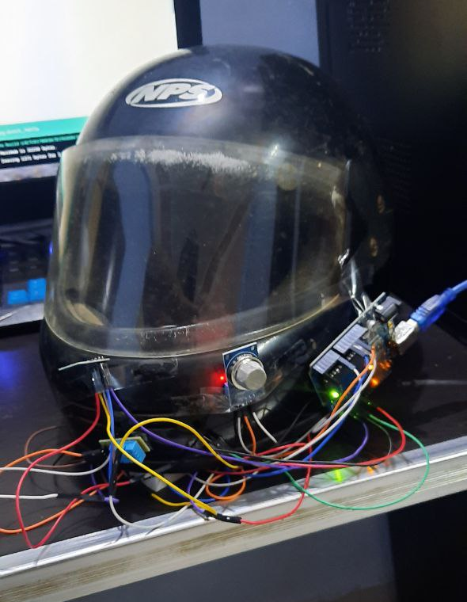
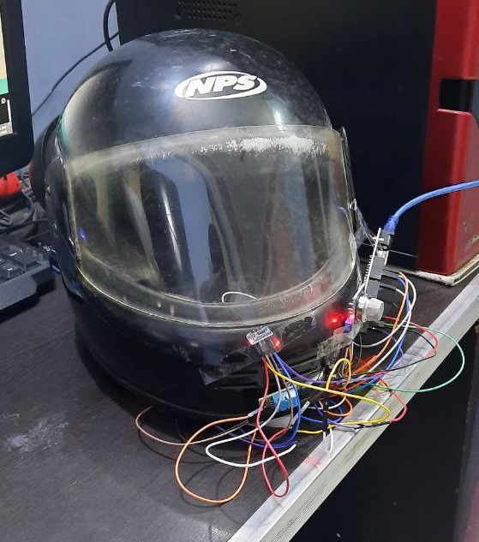
SIMULATION

Slide 10
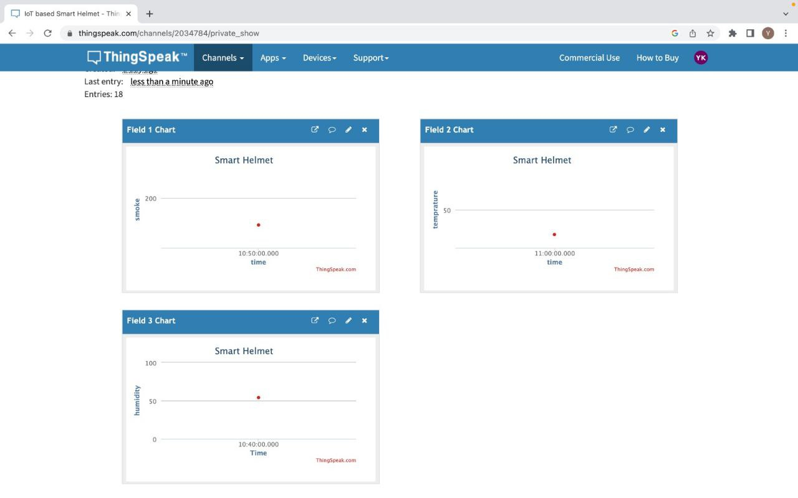
RESULT

Slide 11


